Slide 1
Orthodox Survival Course
Lecture Seven: Ecumenism

Slide 2
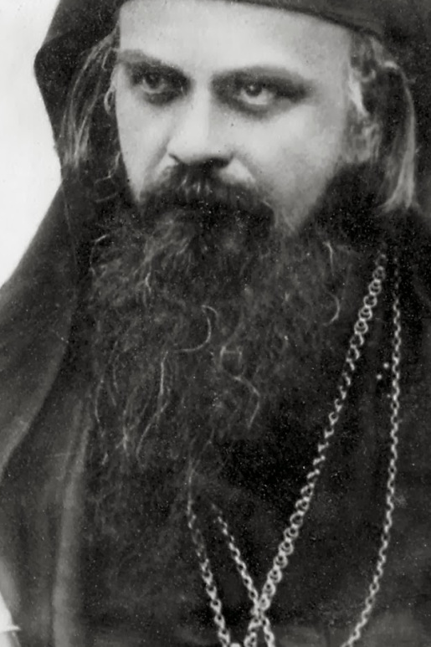
“The supreme happiness of man is the appearance of God in the flesh; however the highest calamity of man is also his apostasy from that same God and his return into the service of Satan.” -St Nikolai Velimirovich

Slide 3
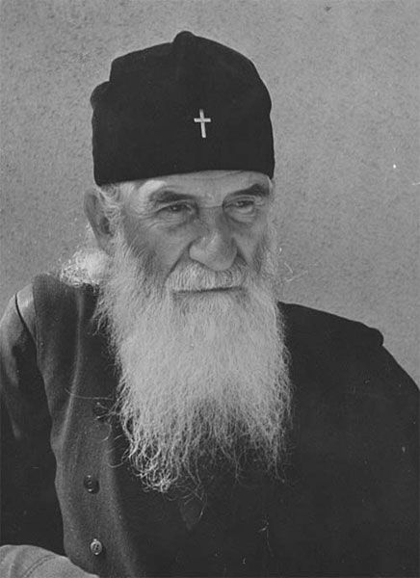
Self-Worship
All centuries give birth to one another and modern man pays the “debt” of his anscestors.

Slide 4
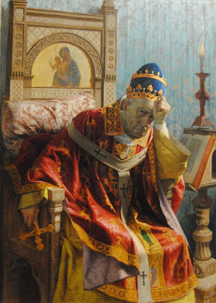
“Ecumenism, is the common name for the pseudo-Christianity of the pseudo-Churches of Western Europe. Within it is the heart of European humanism, with Papism as its head.” -St Justin Popovic

Slide 5
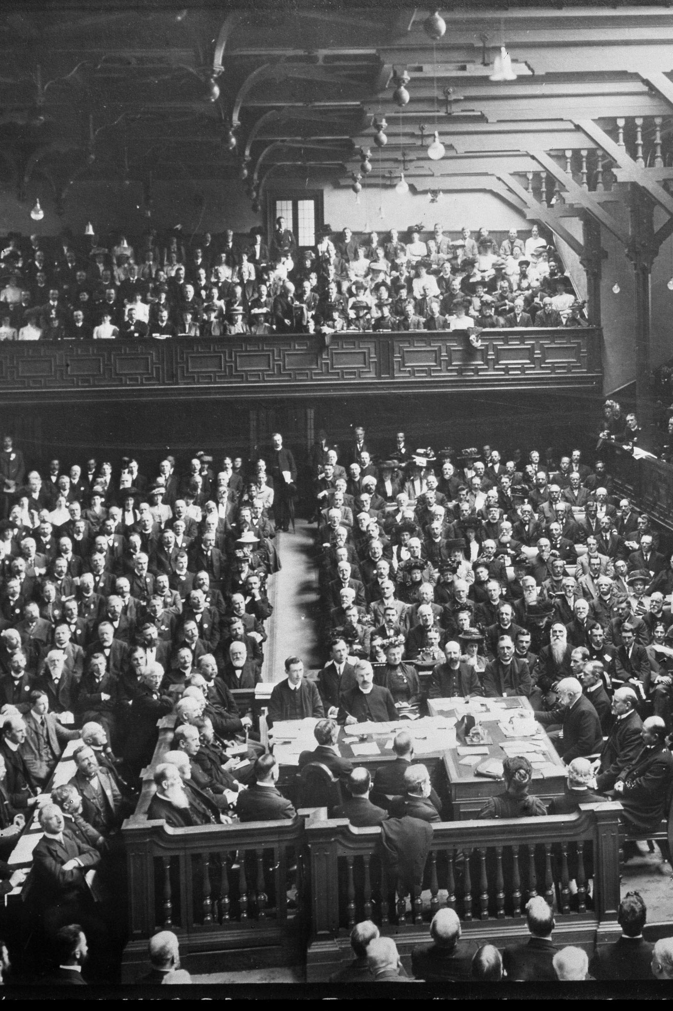
Origins of Modern Ecumenism
World Missionary Conferences
“Invisible Church” Movements
Edinburg 1910

Slide 6
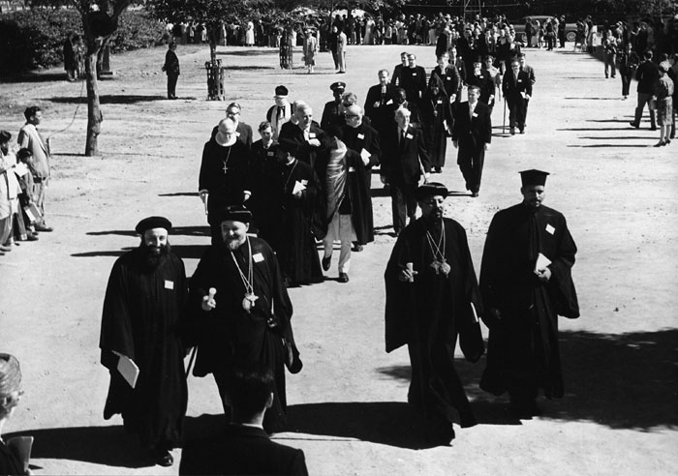
Encyclical of 1920
Widened the definition of the Church
Alliance in Missionary endeavors

Slide 7
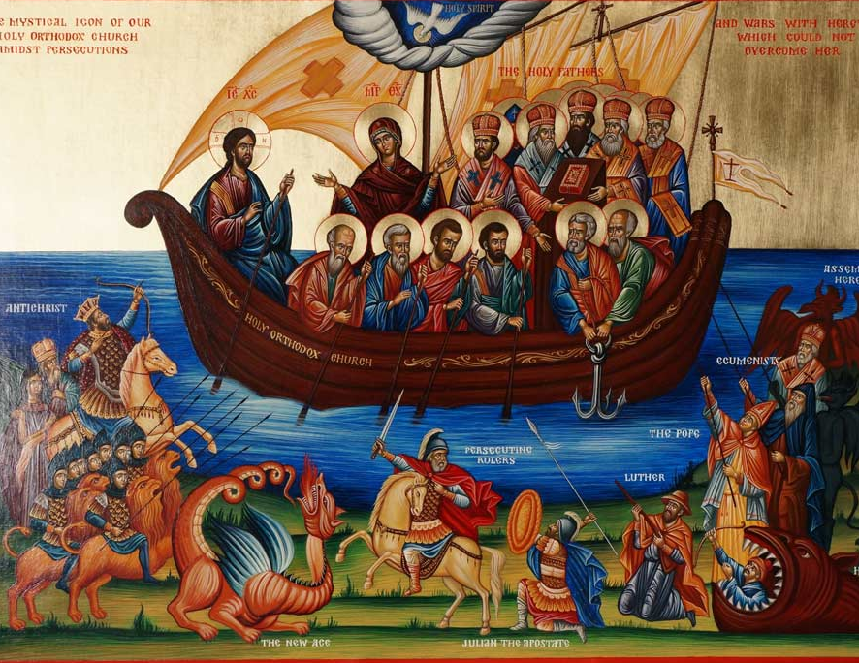
Discerning the Spirits
What is the Church?
Ecumenism as Arianism
Methodology of the Devil

Slide 8
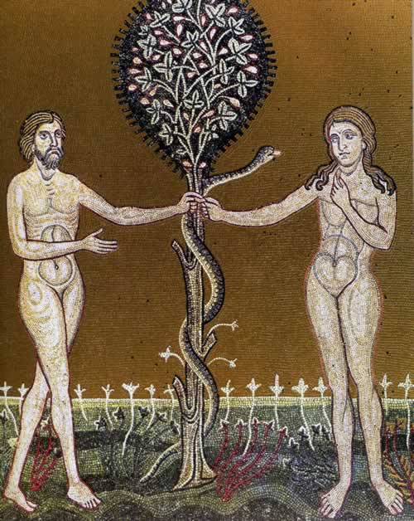
Stages of the Demonic Method At Work
Co-existence
Dialogue
Infiltration
Subversion

Slide 9
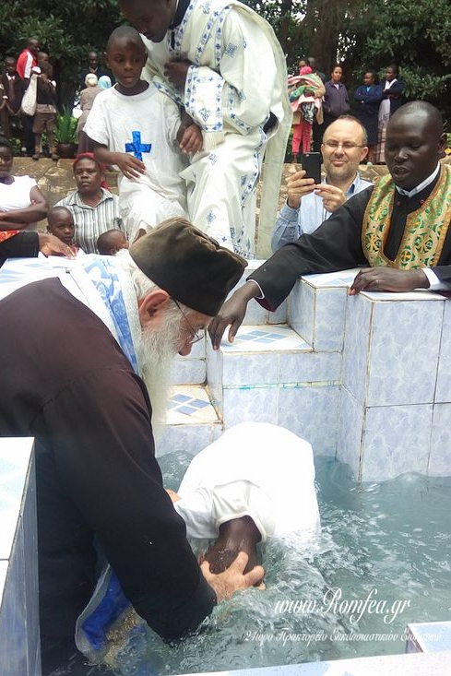
Dialogue in Truth
“You are the salt of the earth; but if the salt loses its flavor, how shall it be seasoned? It is then good for nothing but to be thrown out and trampled underfoot by men” (Matt 5:13).

