Slide 1
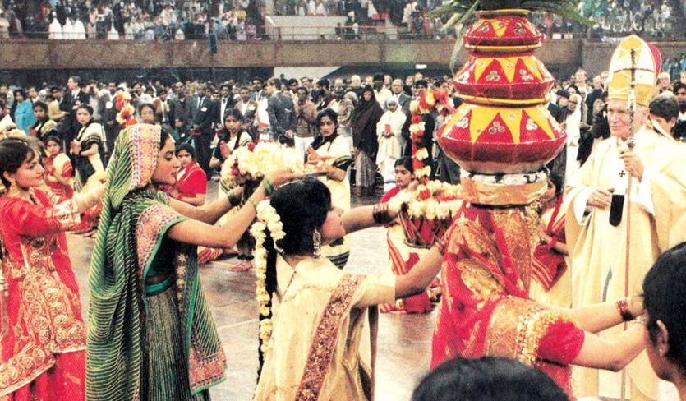
Orthodox Survival Course
“New Religious consciousness”:
Eastern Cults and their invasion of Christianity

Slide 2
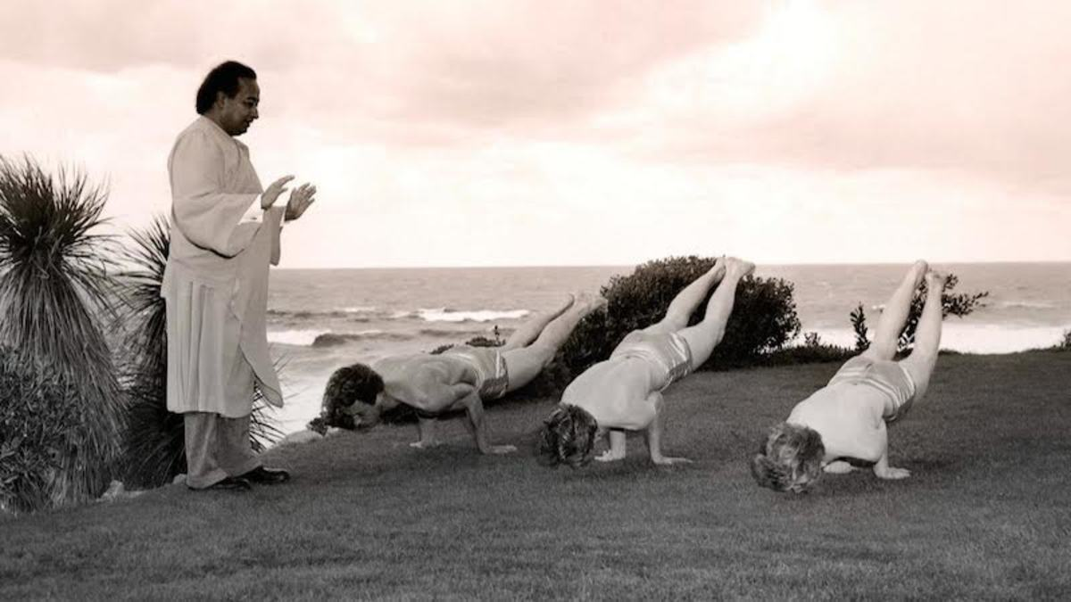
From Fringe to mainstream
What started in the 1950’s as eastern cult ‘fringe’ movements have become mainstream: promoted by popular celebrities, politicians, and generally accepted into every area of life. What was inconceivable 60-70 years ago is completely realized today.

Slide 3
The Spirit Eastern cults
Notes:
Bagwan Shree Rajneesh 1977, (pictured in India)… but later took over Wasco County OR

Slide 4
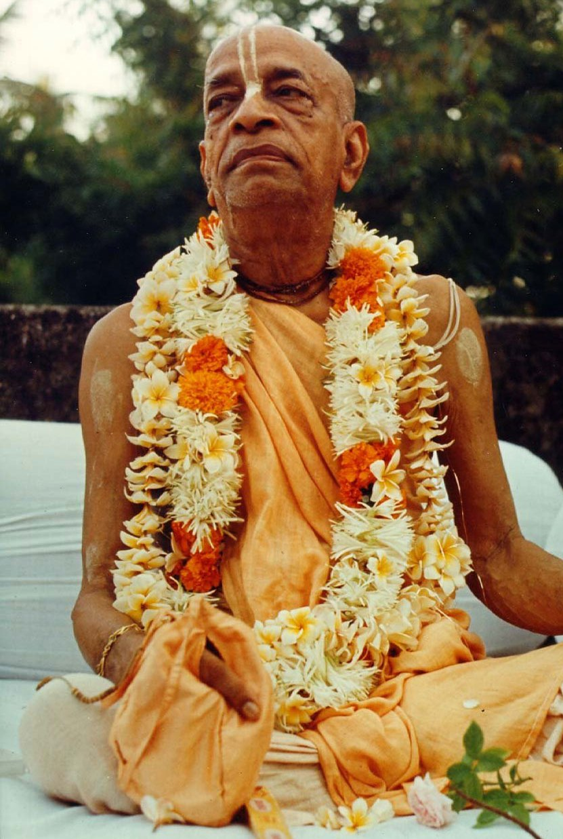
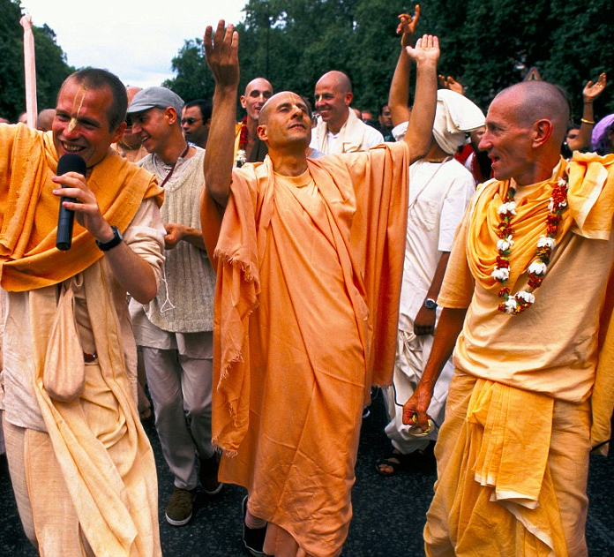
”Krishna Consciousness”
Started by A.C. Bhaktivedanta in 1966
Unlike cults of the 1950’s and 60’s, this demands a full participation and life change.
Union with one’s chosen “god” through Bhakti Yoga.
“Krishna Consciousness” is attained through non-rational worship
If enough people attain this consciousness, the world’s disorder will be repaired and a “new age” of peace, love, and unity will usher in.

Slide 5
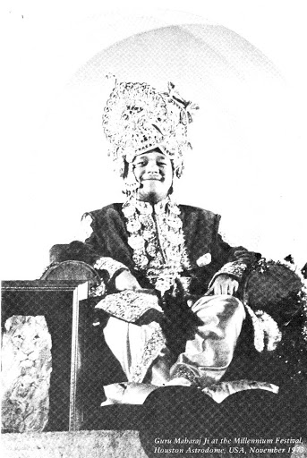
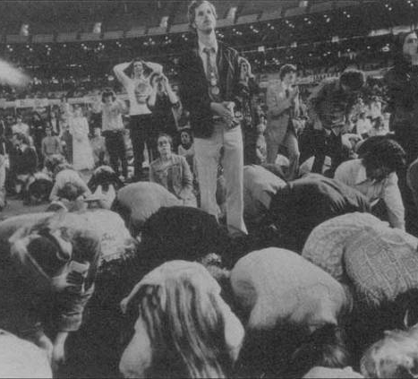
Guru Maharaj-ji and the “Divine Light Mission”
Arrived in fall of 1973 with the practice that would be popularized as “transcendental meditation.”
15 years old and proclaimed to be God, “Lord of the Universe,” and amassed at least 80,000 followers who believed he had come to usher in a new age of peace for mankind.
Demanded full initiation, the changing of one’s life, and the giving up of worldly pleasure.
Required meditation techniques were promised to help gain an “expanded” consciousness which would make followers perfectly peaceful, happy, and ‘blissed out.’
Big event: Millennium ‘73

Slide 6
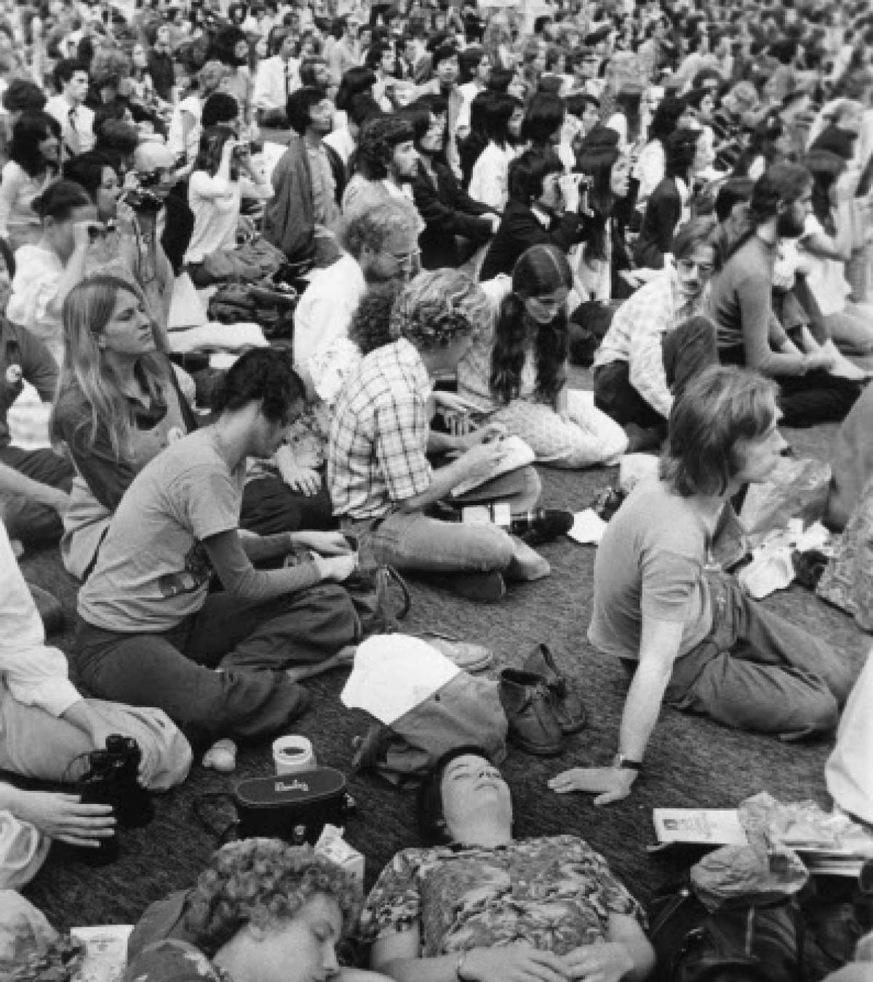
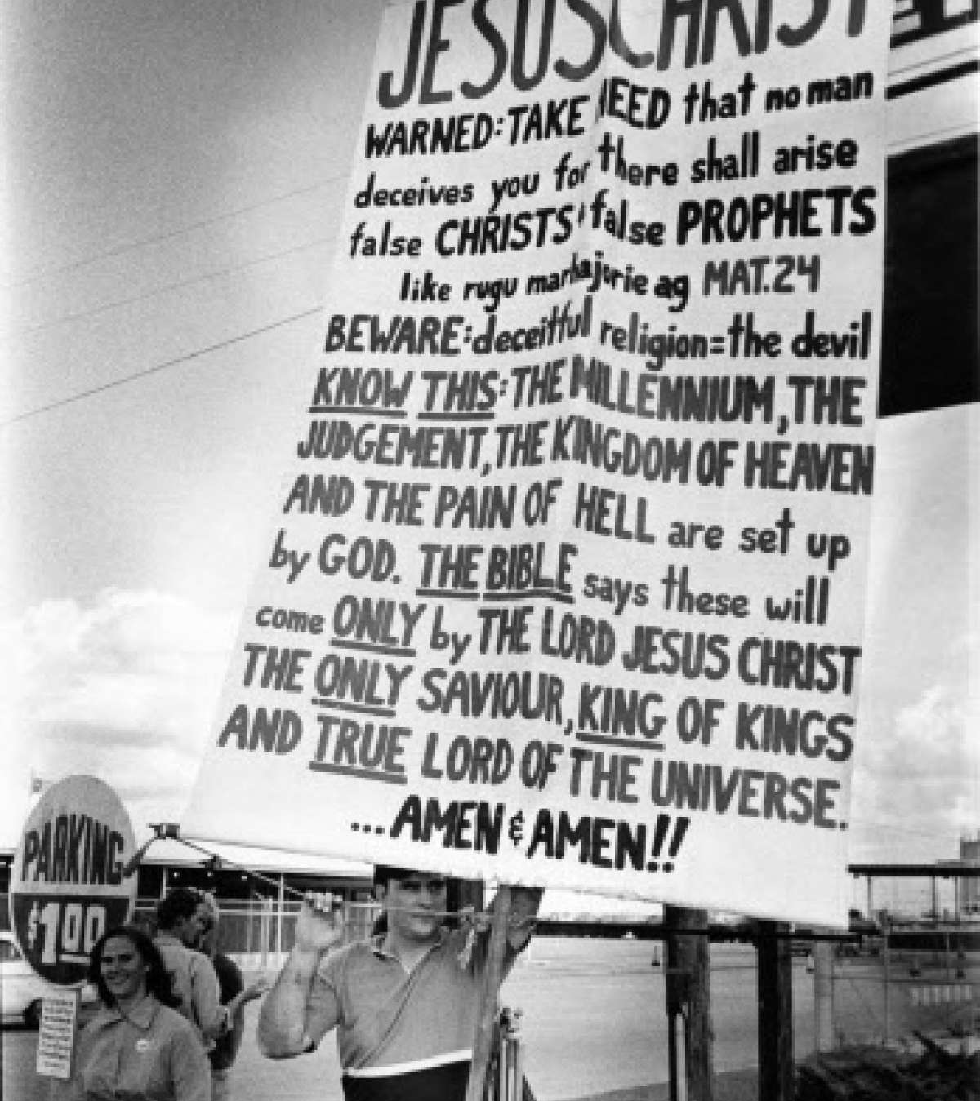

Slide 7
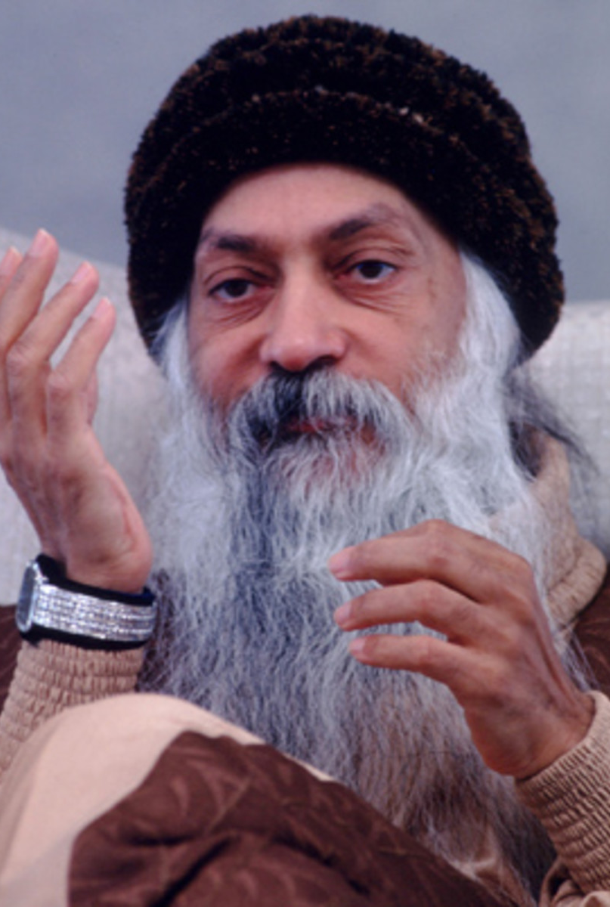
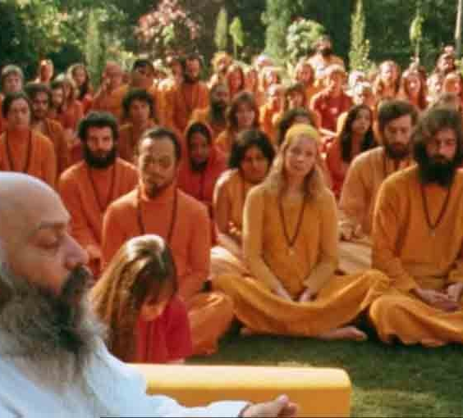
Bhagwan Shree Rajneesh
Proclaimed “godman” and leader of the Rajneesh Movement
Expanded Hindu practices with various other neo-movements and included western philosophies. Rejected all traditional belief structures as “supressive” of what he emphasized as important of meditation, mindfulness, love, celebration, courage, creativity, and humor.
Rooted in India but came to America in 1981 due to rejection from India’s ruling party and the fact he owed $5 million in taxes.
His followers built an enormous compound, took control of local governments, organized mass food poisonings, made assassinations plans for politicians.
Promoted the creation of a “new man” through his spiritual practices merged with science. New man “would no longer be trapped in institutions such as family, marriage, political ideologies and religions.”

Slide 8
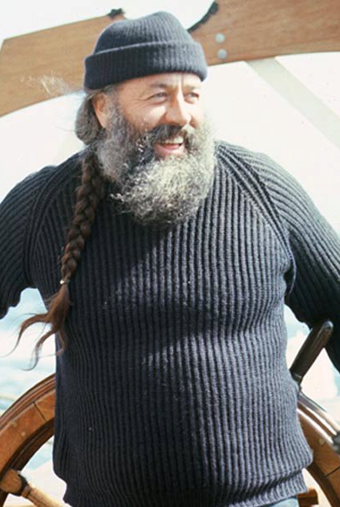
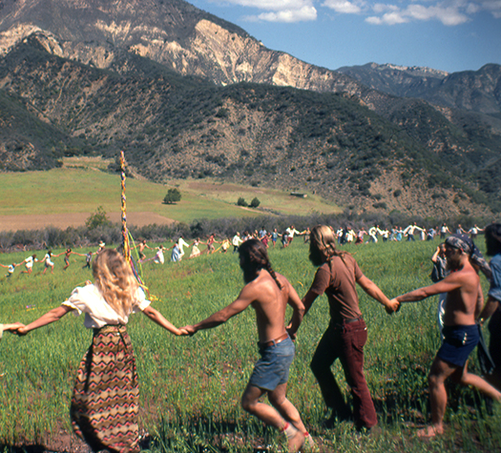
Norman Paulsen and the “Brotherhood of the Sun”

Slide 9
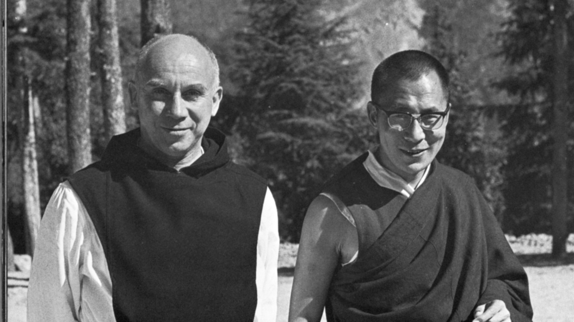
Eastern Meditation invades Christianity

Slide 10
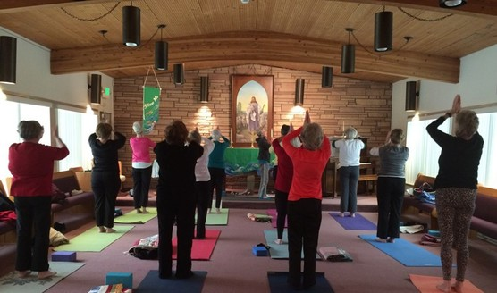
“Christian Yoga”
Hindu Yoga has become popularized through cults and also supposed physical therapy which has supposed non-religious aims. Thus there are two pitfalls which are equally deadly:
Religious:
To use Yoga as a way to meditate, enhance your “Christian” experience,” to relax in order to enter into prayer, etc. [[READ 39]
As Physical Therapy or Exercise:
To think that Yoga can be divorced from its religious context and thus be able to be adapted and practiced safely.

Slide 11
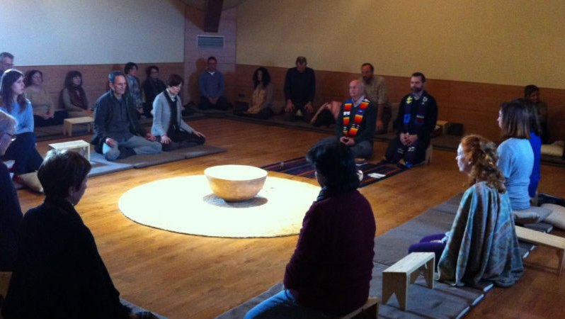
“Christian Zen”
Christians seeking new forms of “prayer” because they are dissatisfied with their own traditions.
Zen seeks to abolish rational thinking and attain a state of simplicity that brings calm and a state of silent meditation.
Syncretic. There is no distinguishing between evil and good.

Slide 12
“Christian Meditation” (TM)
Became very popular rapidly in America, (the fast food of eastern meditation)
Quick initiation and experience
Does not require any belief
Promises new states of consciousness
Those who experience this first receive all sorts of gifts: healing of families, overcoming addiction, etc., but later many experience the same traumatic effects as those who dabble in the occult: mental and emotional illness, suicide, attempted murder, or demonic possession.

Slide 13
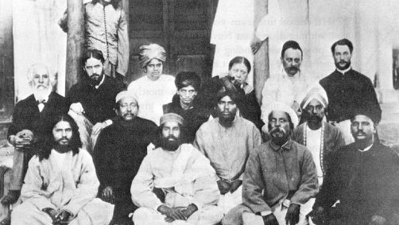
The Leaven FOR A NEW AGE

